Slide 1


Notes:
Thank you for the welcome and also thank you to the wonderful organizing team, the volunteers , the sponsors but most importantly thank you for being apart of such a great community and being here today.
I know sometimes it is hard fight off the inevitable food coma after such a wonderful lunch, during the first time slot post lunch so I decided to take a different approach to this presentation to hopefully get you pumped up and to fight off the tyranny of the calories consumed.
So with that Lets get started….

Slide 2
Agenda
Manage Expectations
History Lesson
Once over of Windows Event Log Basics
Hopefully, Interesting Content Here
Additional Content, Continued…
Demo(s)?!?!?
Q&A

Slide 3
What is lurking in your event logs?

Slide 4
What Not to Expect…
Payload Obfuscation
AMSI/Defender Bypass
EDR/XDR Evasion
Notes:
You may already have enough context clue to put the entire puzzle together based on what you just saw, but some of you may not so I think it is important to clarify some things before we progress forward.
The result of the discussion will not involve these three subjects. They are not needed, and frankly would be an exercise for you the audience if you so chose.

Slide 5
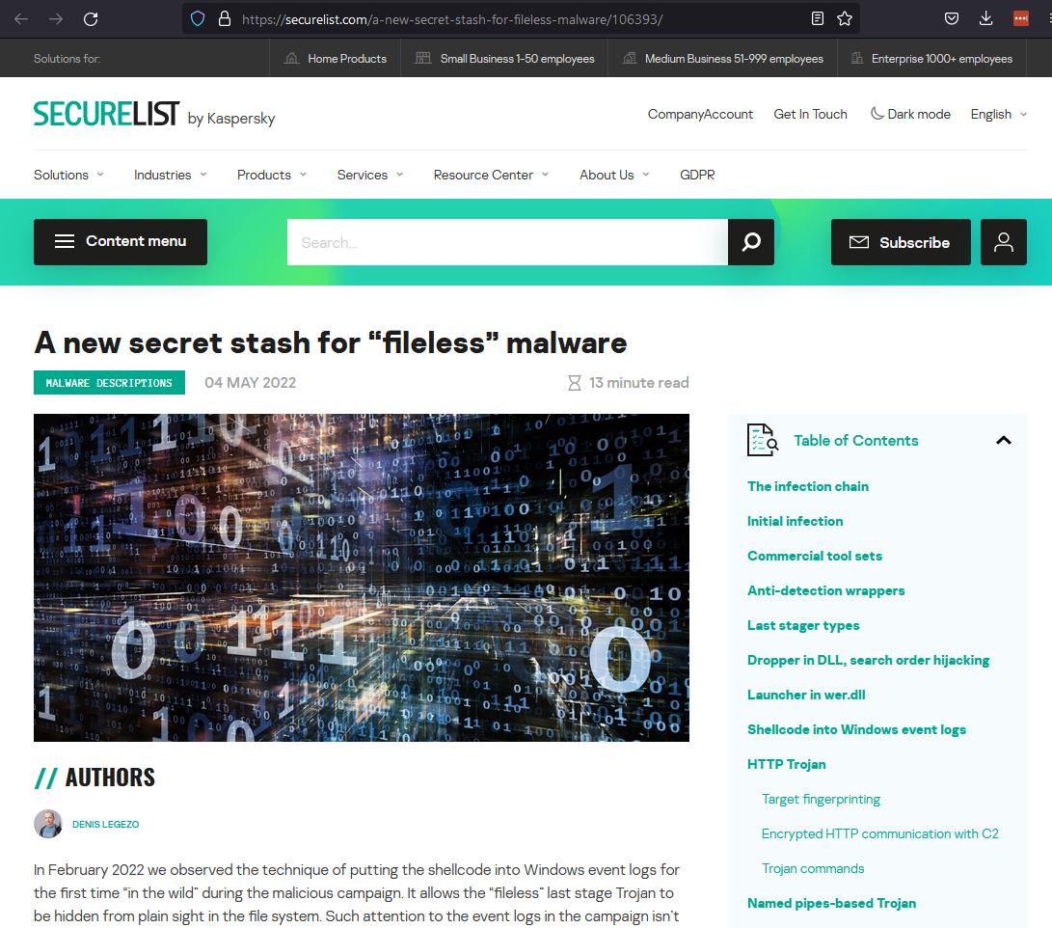
May 4, 2022
"In February 2022 we observed the technique of putting the shellcode into Windows event logs for the first time “in the wild” during the malicious campaign. It allows the “fileless” last stage Trojan to be hidden from plain sight in the file system.“ - SecureList by Kapersky

Slide 6
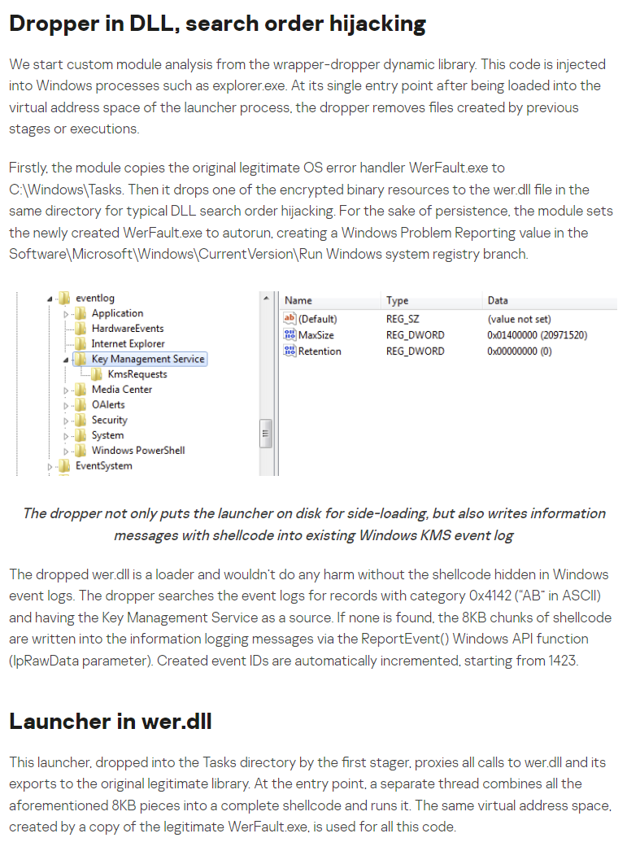
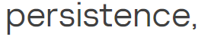
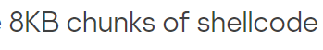

Slide 7
First the basics…

Slide 8
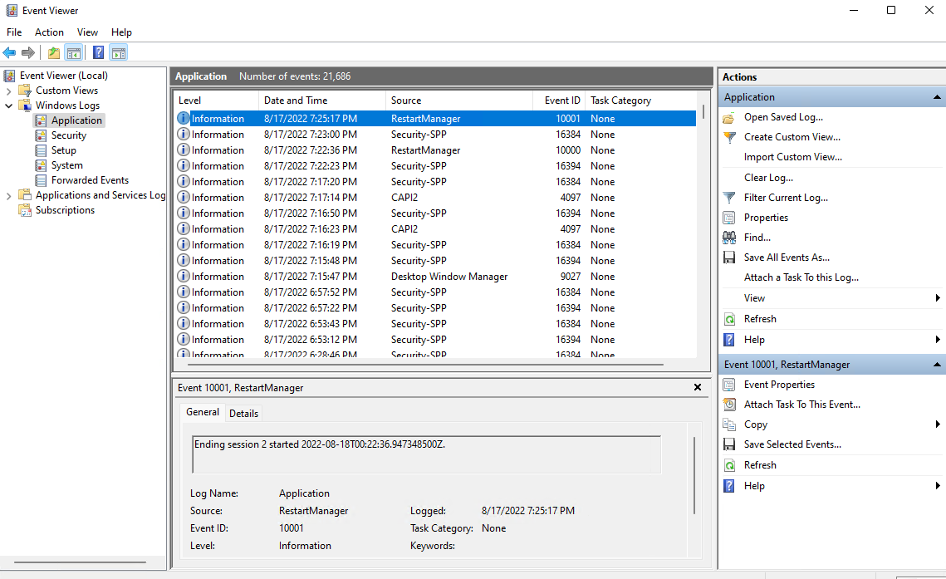
Windows Event Log Basics
Windows event logs use a structured data format to record events that happen within the operating system, software, hardware-based events.

Slide 9
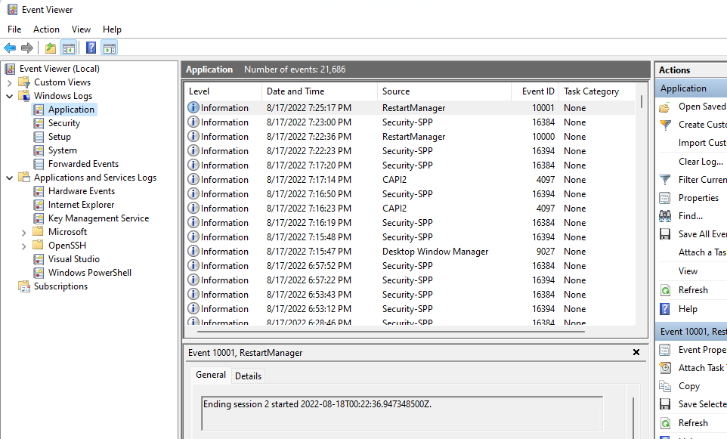

Slide 10
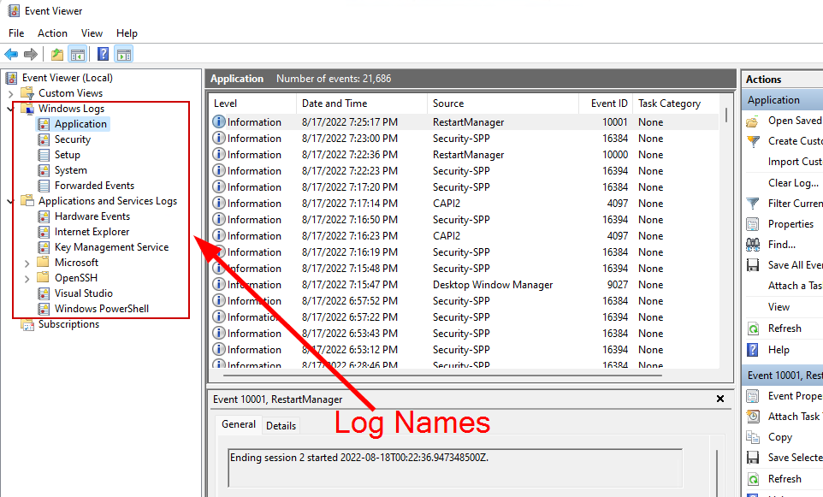

Slide 11
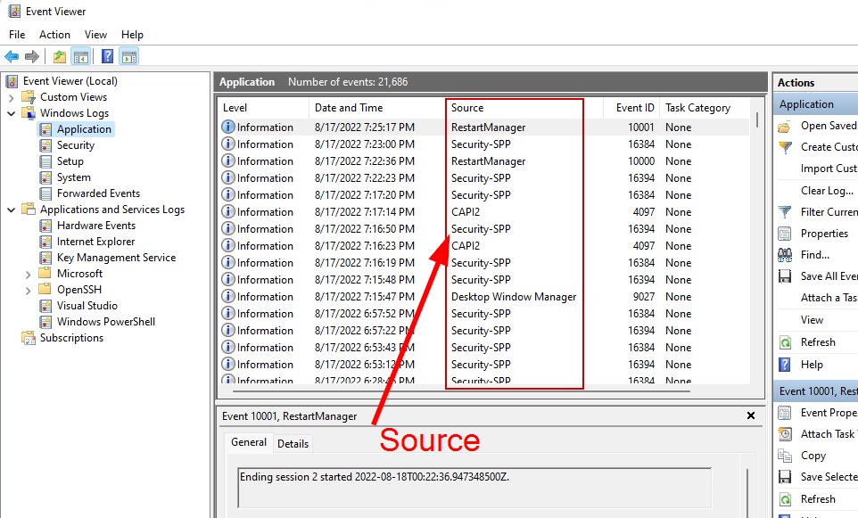

Slide 12
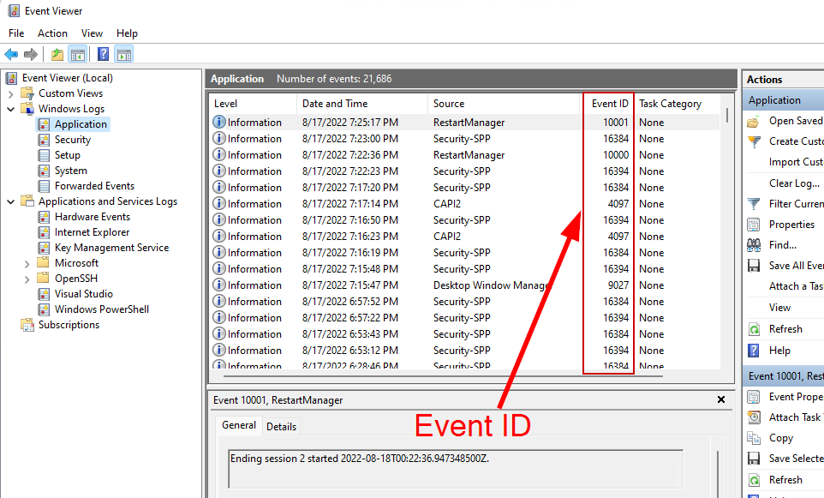

Slide 13
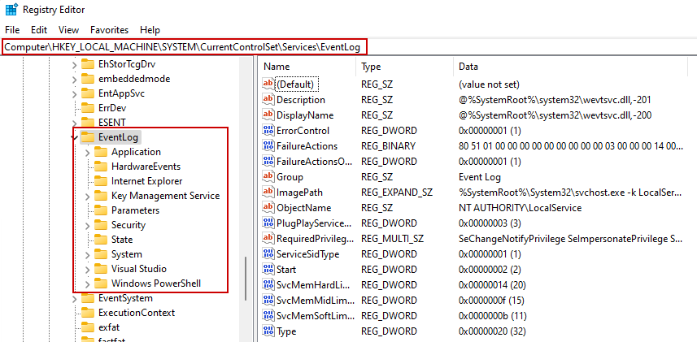
Event Logs in Windows Registry

Slide 14
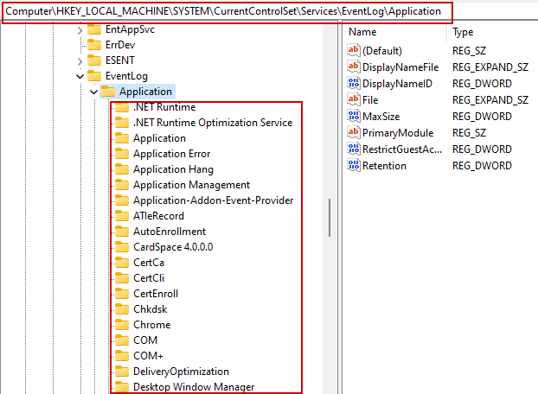
Event Sources

Slide 15
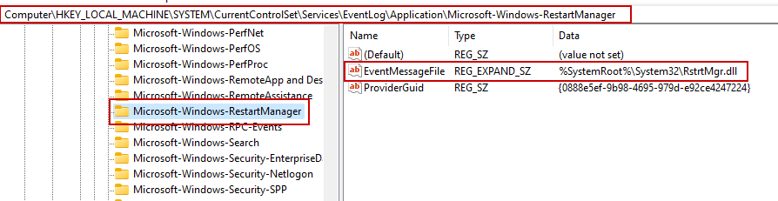
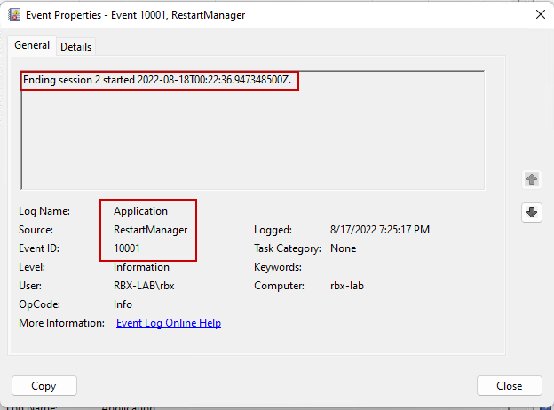
Event Message Files

Slide 16
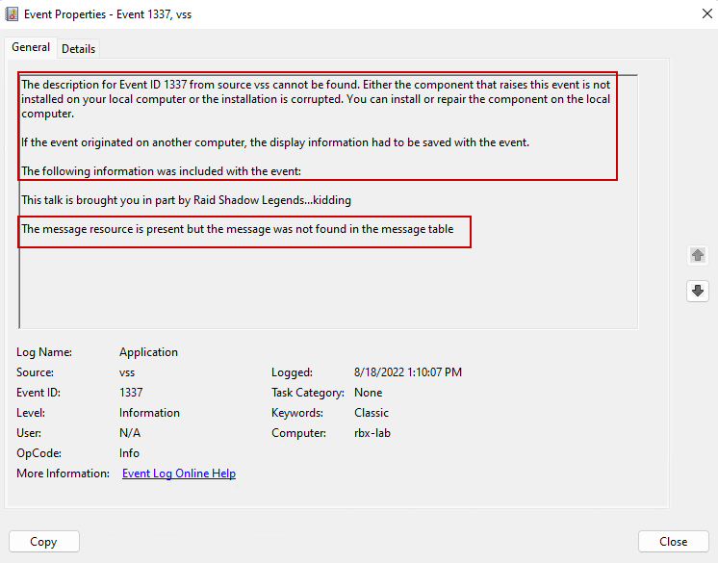
Event Message Files
If a source does not a message corresponding to the EventID issued, you will see a message like this.

Slide 17
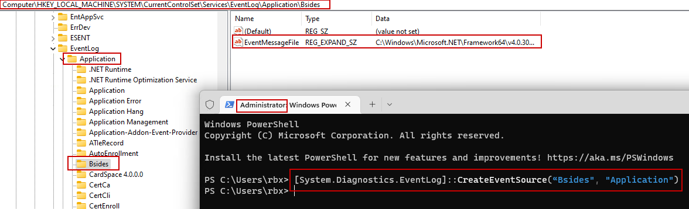
Creating Logs/Sources (As Admin)
Notes:
### This requires you to be Admin
[System.Diagnostics.EventLog]::CreateEventSource(“Bsides", "Application")
[System.Diagnostics.EventLog]::WriteEntry(“Bsides", "This is a sample event entry", "Information", 100)

Slide 18
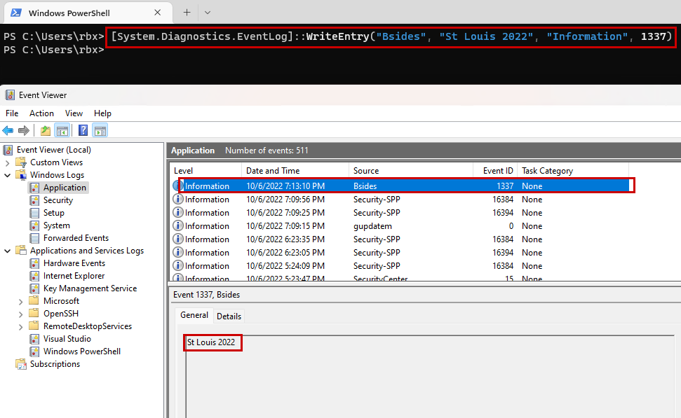

Slide 19
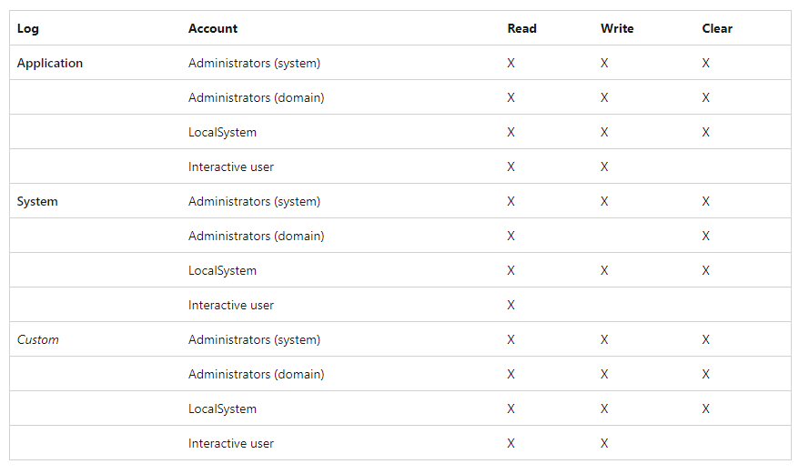
Event Log Security
Notes:
https://docs.microsoft.com/en-us/windows/win32/eventlog/event-logging-security

Slide 20
Now what…?

Slide 21
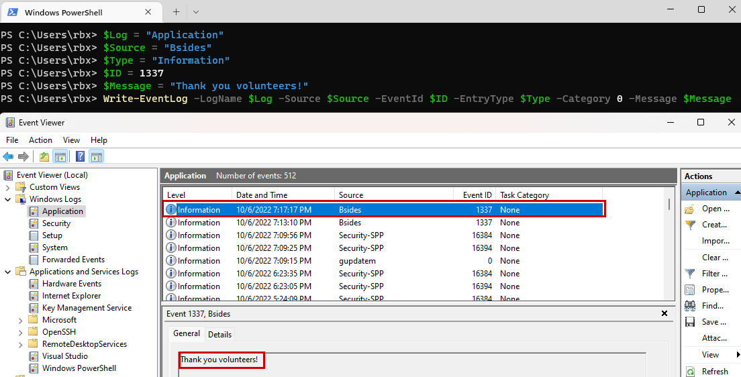
Creating an Event Log

Slide 22
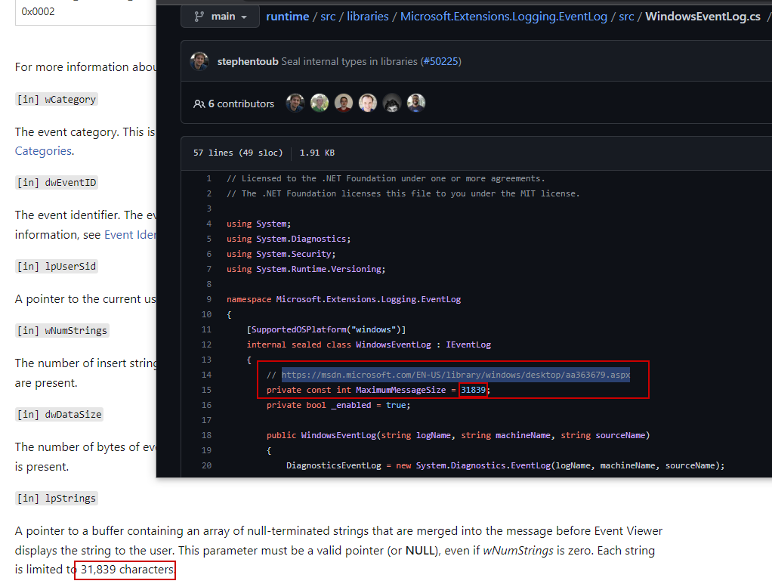
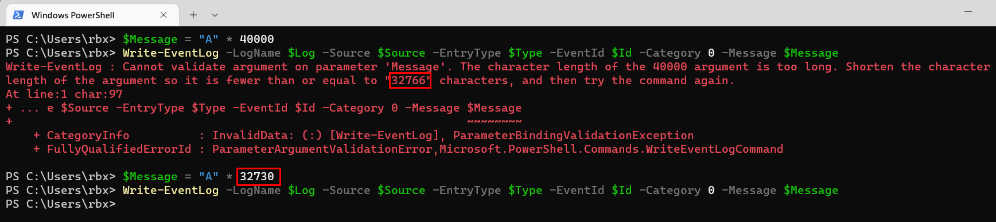
Total size of Event log message cannot exceed 31,839 bytes???

Slide 23
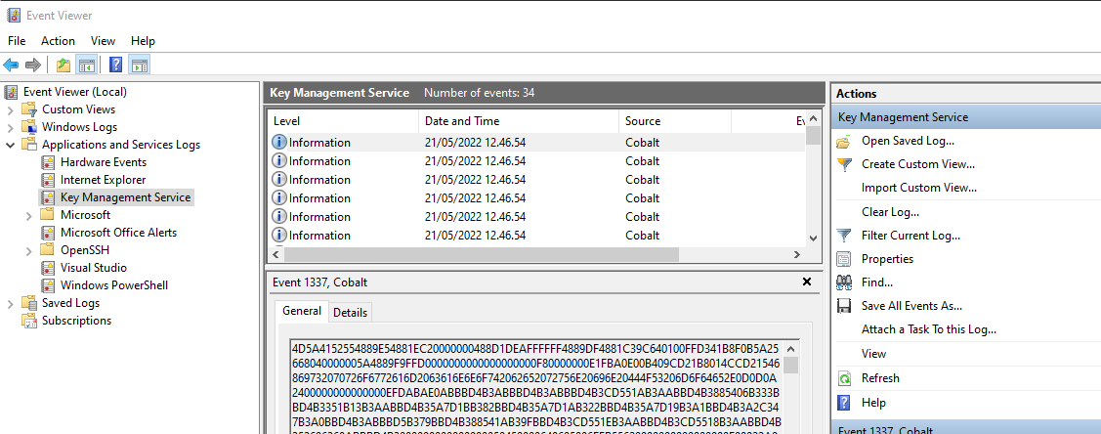
https://github.com/improsec/SharpEventPersist

Slide 24
But wait…there is more!

Slide 25
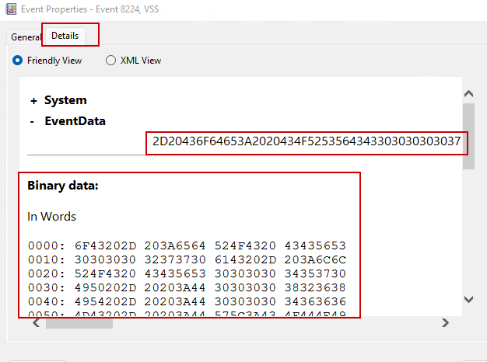
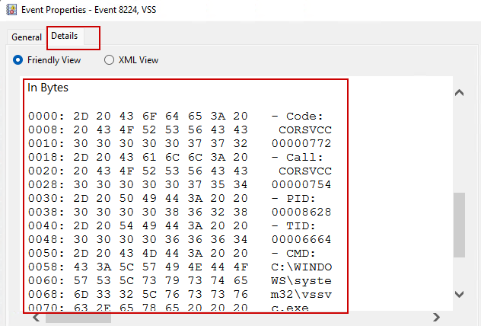

Slide 26
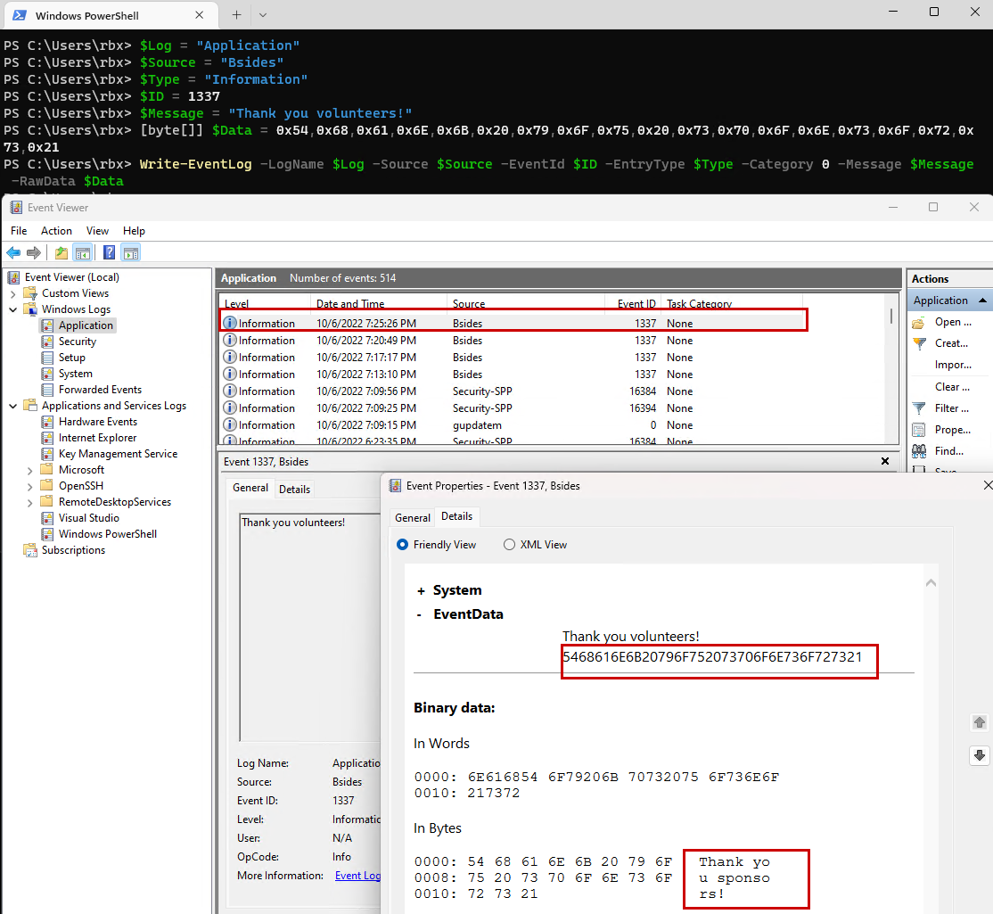
Binary data can be included in an Event Log if it is passed as a byte array

Slide 27
How much data can be stored??
61,440 Bytes
Notes:
61,440 bytes = 60KB

Slide 28
Starting to get offensive…
Notes:
At this point we have covered the enough of the basics of windows event logs to understand what is going on and how we can manually create our own event logs and even event sources.
This was the point in my research efforts were the clear goal of weaponization of the ability to arbitrarily inject binary data into event logs.

Slide 29
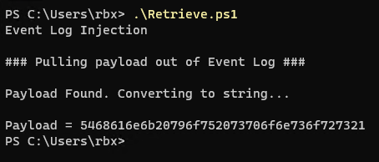
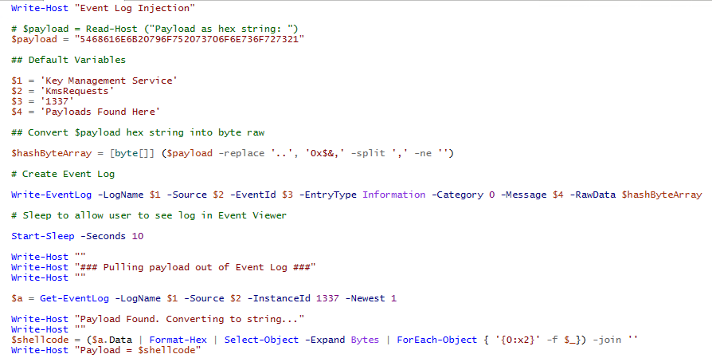
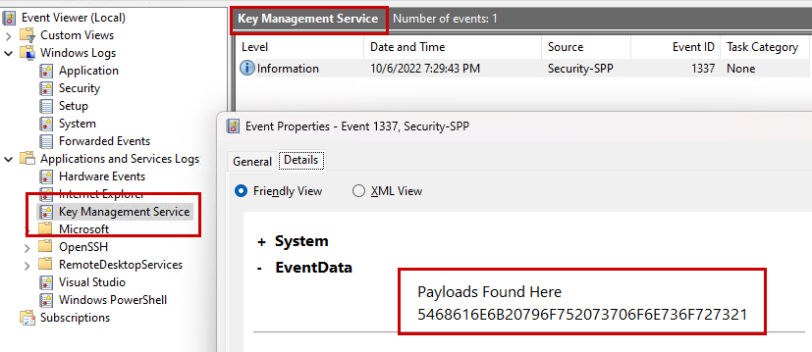
Retrieving Payload from Event Logs

Slide 30
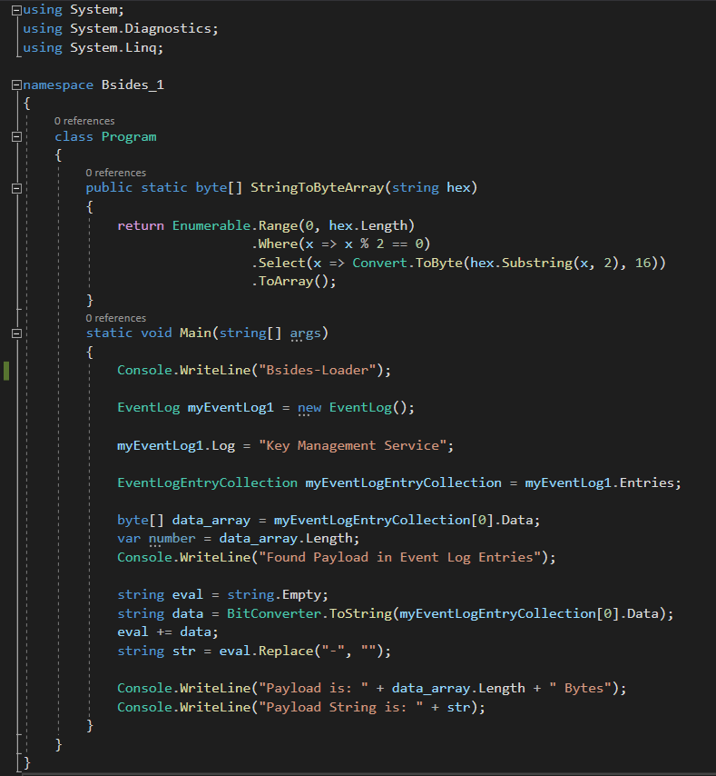
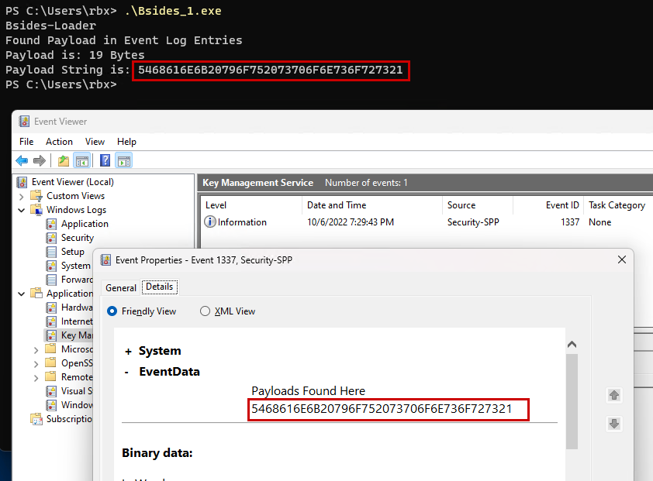
Notes:
dotNet

Slide 31
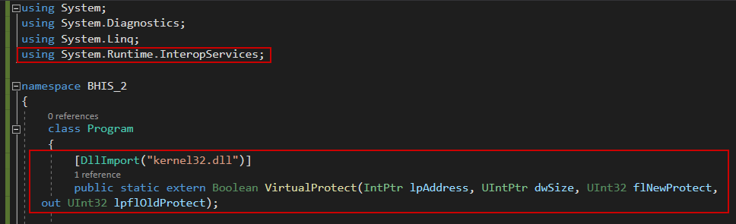
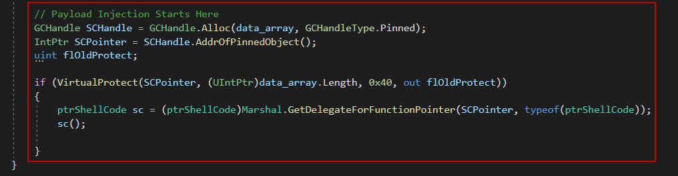
Notes:
Calc.exe

Slide 32
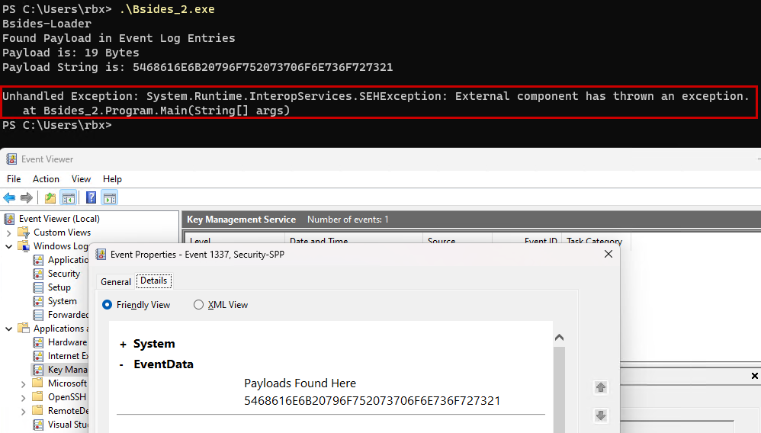
Notes:
Demos

Slide 33
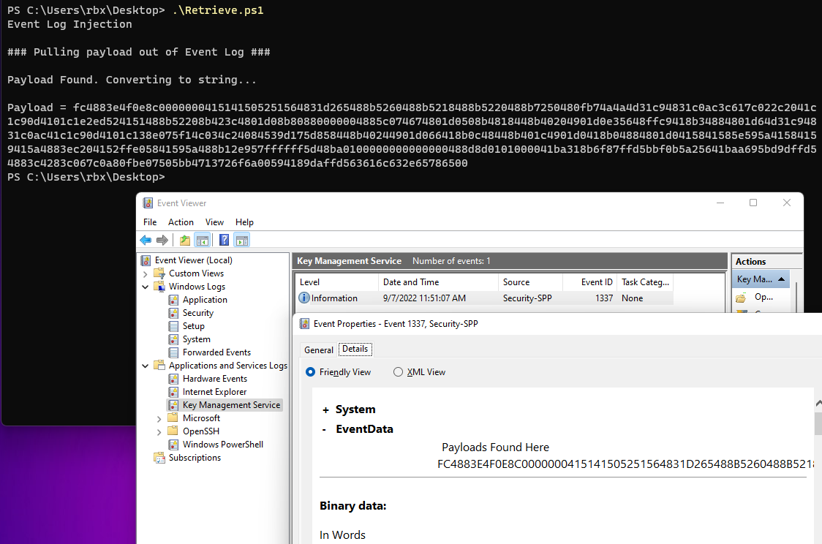
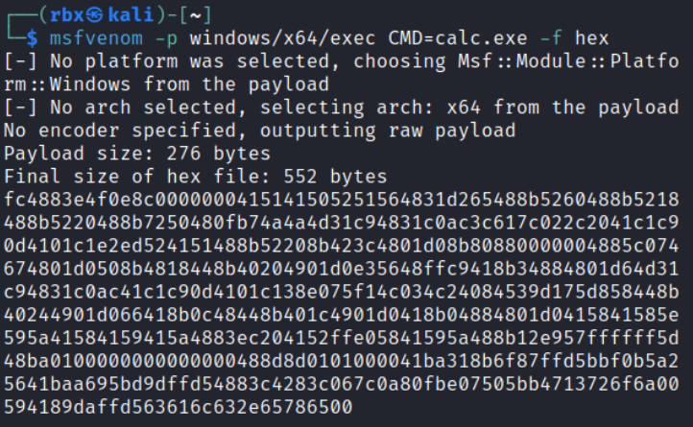

Slide 34
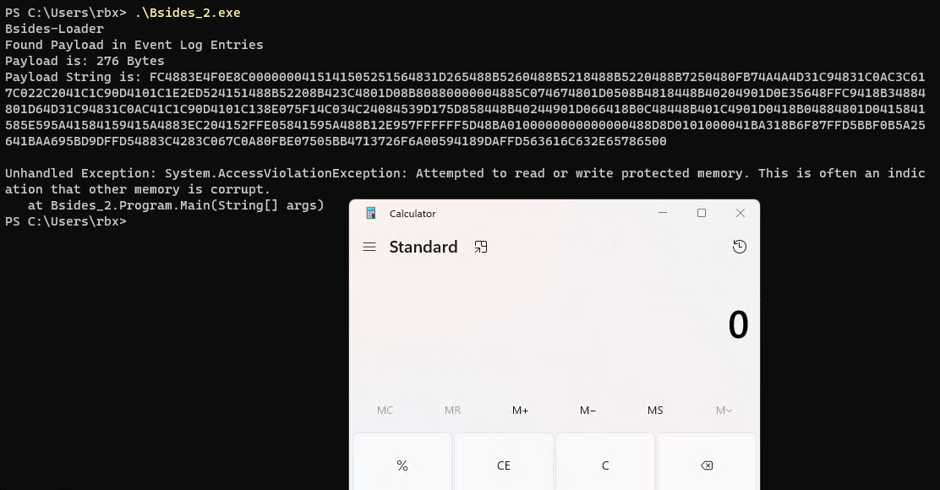

Slide 35
Now we’re getting somewhere…
Let’s go live!

Slide 36
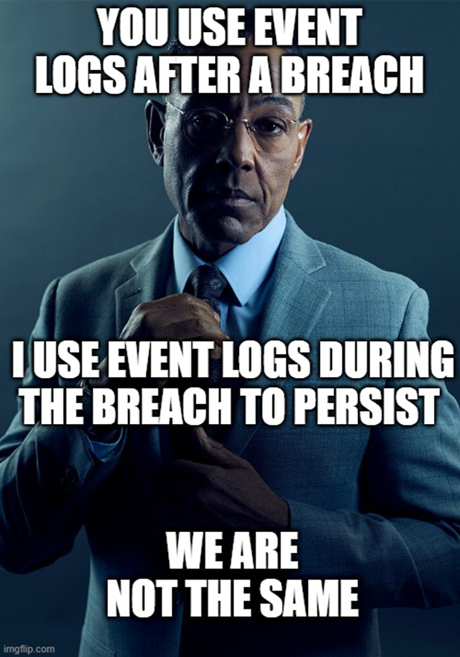
In Conclusion

Slide 37
#:~ whoami
Tim Fowler – @roobixx
BHIS – Offensive Security Analyst
Slides and Code can be found on GitHub
https://github.com/roobixx/bsides-stl-2022

Slide 38
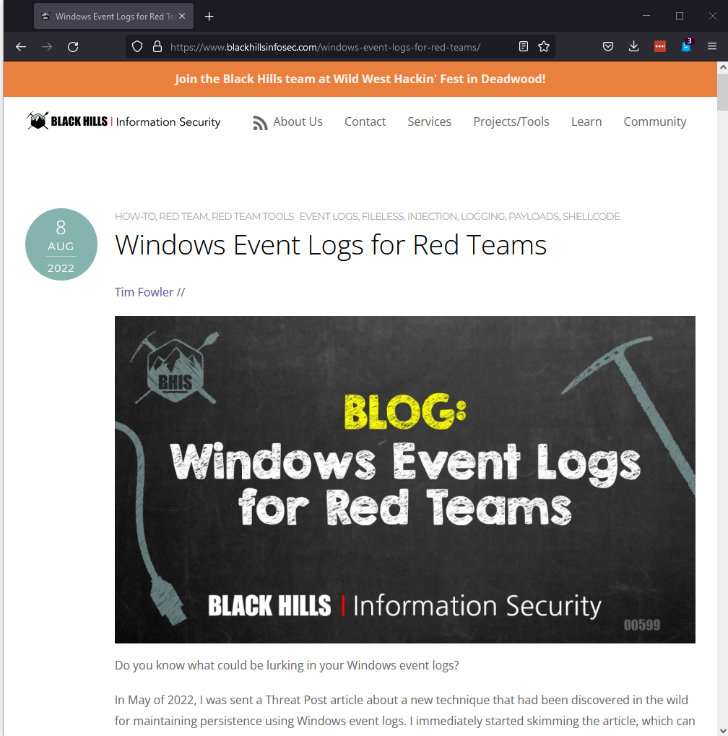
https://www.blackhillsinfosec.com/windows-event-logs-for-red-teams/

Slide 39
References
https://threatpost.com/attackers-use-event-logs-to-hide-fileless-malware/179484/
https://securelist.com/a-new-secret-stash-for-fileless-malware/106393/
https://docs.microsoft.com/en-us/windows/win32/eventlog/event-logging-security
https://github.com/improsec/SharpEventPersist

